Slide 1
BLUE BRAIN TECHNOLOGY
Vaagdevi Collage of Engineering
Submitted by
Preetham arun
15641A5k7
CSE

Slide 2
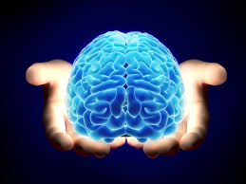
BLUE BRAIN TECHNOLOGY
Notes:
K.PRIYANKA
B15IT002
IT

Slide 3
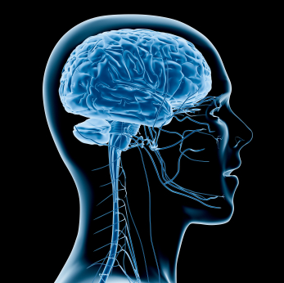
CONTENTS
INTRODUCTION
WHAT IS VIRTUAL BRAIN
BRAIN BEHIND BLUE BRAIN
UPLOADING HUMAN BRAIN
REQUIREMENTS
BLUEBRAIN POWER
ADVANTAGES
DISADVANTAGES
APPLICATIONS
EXAMPLES
CONCLUSION
Notes:
INTRODUCTION

Slide 4
INTRODUCTION
HUMAN BRAIN:
Human brain is the most valuable creation of God.
The man is called intelligent because of the brain, but we lose it when body is destroyed i.e after the death.
BLUE BRAIN:
The world’s first virtual brain which works same as human brain.

Slide 5
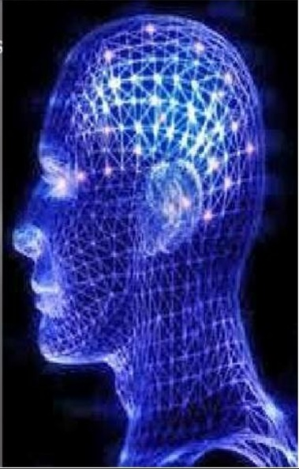
WHAT IS VIRTUAL BRAIN?
A machine that can function as a brain.
It can take decisions.
It can think.
It can respond.
It can keep things in memory.

Slide 6

Is it really possible to create a human brain?
YES, the IBM is now developing a virtual brain known as the BLUE BRAIN.
It would be the world’s first virtual brain. Within 30 years, we will be able to scan ourselves into the computers.

Slide 7
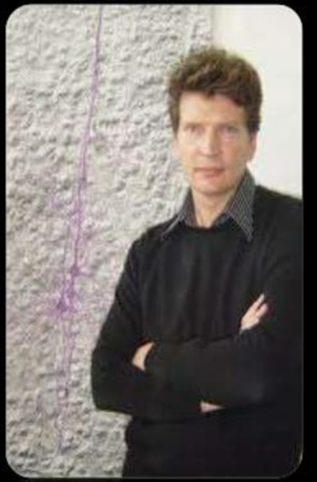
BRAIN BEHIND BLUE BRAIN
HENRY MARKRAM
Director of Blue Brain project.
Founder and co-director of EPFL’s institute.
Project was founded in May 2005.

Slide 8
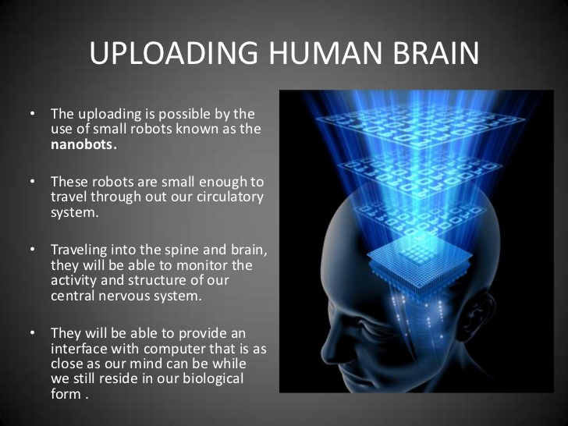

Slide 9
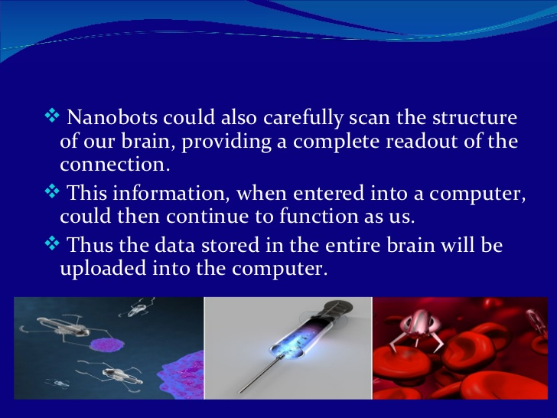

Slide 10
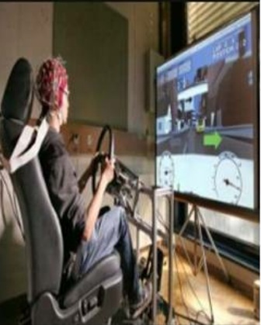
BLUE BRAIN POWER
Blue Brain will reveal many existing aspects of the brain circuits ,memory capacity and how memories are lost.
The modeling is also able to work out best way to compensate and repair error circuits.
The blue brain model can be used to detect and test treatment strategies for neurological diseases.

Slide 11
ADVANTAGES
Remembering things without any effort.
Making decision without presence of a person.
Using intelligence of a person after the death.
Understanding the activities of animals.
Allowing the deaf to hear via direct nerve stimulation.

Slide 12
DISADVANTAGES
We become dependent upon the computer.
Others may use technical knowledge against us.
Another fear is found with respect to human cloning.
A very costly procedure of regaining the memory back.

Slide 13
APPLICATIONS
NATIONAL SECURITY
BORDER SECURITY
TO DEVELOP A NEW BREED OF SUPER COMPUTER
GATHERING AND TESTING 100YEARS OF DATA
CRACKING THE NEURAL CODE
A NOVEL TOOL FOR DRUG DISCOVERY FOR BRAIN DISORDERS

Slide 14
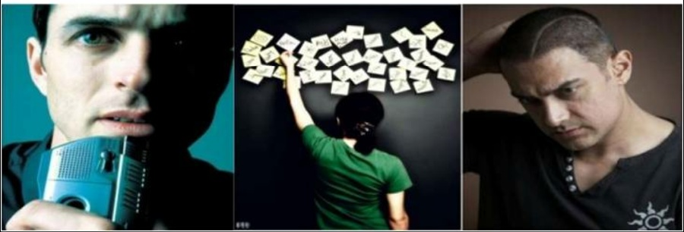
Examples of utilization of Blue Brain
A very good example of utilization of blue brain is the case “short term memory”.
In some movies we might have noticed that a person might be having short term memories.

Slide 15
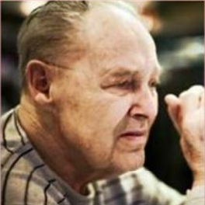
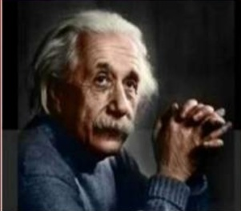
Another situation is that when a person gets older then he starts forgetting or takes a bit more time to recognize a person.
Great inventory brains like Einstein,Newton can be reused for further inventions and expansion of technology.

Slide 16
Conclusion
We will be able to transfer ourselves into computer at same point.
It will bring both benefits and harm to human society.
Eventually aim of applying terrific computer power to the simulation of an entire brain.
Very soon this technology will be highly accepted by whole over the world.

Slide 17


Slide 18


